Slide 1
Software
Programs
Documentation
Operating Procedure

Slide 2
Software Engineering
The term software engineering is the product of two words, software, and engineering.
The software is a collection of integrated programs.
Engineering is the application of scientific and practical knowledge to create, design and maintain processes.
It is a process of analyzing the requirements of user and then designing, building, and testing software application which will satisfy these requirements.

Slide 3
IEEE Definition of Software Engineering
Software engineering as the application of a systematic, disciplined, which is a computable approach for the development, operation, and maintenance of software.

Slide 4
Boehm’s Definition of Software Engineering
The practical application of scientific knowledge to the creative design and building of computer programs.
It also includes associated documentation needed for developing, operating, and maintaining them.

Slide 5
Why Study Software Engineering?
Software Engineering applies the knowledge and theoretical understanding gained through computer science to building high-quality software products

Slide 6
Manuals in Documentation
Formal Specification
Analysis/Specification
Context-Diagram
Data Flow Diagrams
Flow Charts
Design
Entity-Relationship
Diagram
Documentation Manual
Implementation
Source Code Listings
Cross-Reference
Listing
Test Data
Testing
Test Results

Slide 7
Open Source Software
Software in which source code is available is known as Open Source Software.
Ex: PHP, Linux, MySQL etc.

Slide 8
Need of Software Engineering
Reduce Complexities
Software engineering divides big problems into various small issues and then start solving each small problem one by one.

Slide 9
Need of Software Engineering(cont..)
DecreaseTime
Anything that is not made according to the project always wastes time.
And if you are making software/application, then you may need to run many codes to get final running code.
if you are making your software according to the software engineering method, then it will decrease a lot of time.

Slide 10
Characteristics of Software
Functionality
It refers to the degree of performance of the software against its intended purpose. It basically means are the required functions.

Slide 11
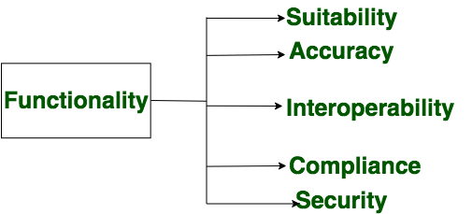

Slide 12
Characteristics of Software
Reliability
A set of attribute that Bear on the capability of software to maintain its level of performances understated conditions for a stated period of time.

Slide 13
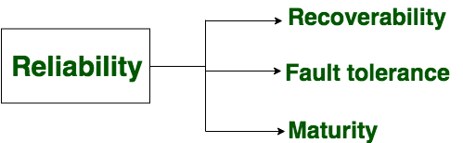

Slide 14
Characteristics of Software
Efficiency
It refers to the ability of the software to use System Resources in the most Effective and Efficient Manner. The software should make effective use of storage space and executive commands as per desired timing requirement.

Slide 15
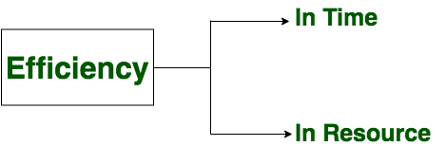

Slide 16
Characteristics of Software
Usability
It refers to the extent to which the software can be used with ease. Or the amount of effort or time required to learn how to use the software should be less.

Slide 17
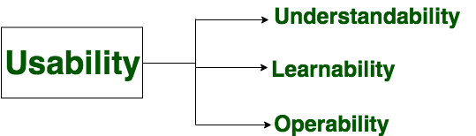

Slide 18
Characteristics of Software
Maintainability
Refers to the ease with which the modifications can be made in a software system to extend its functionality, improvement, performance or correct errors.

Slide 19
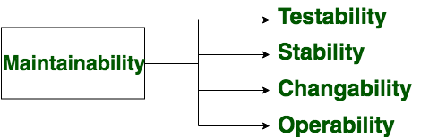

Slide 20
Characteristics of Software
Portability
A set of attributes that bears on the ability of the software to be transferred from one environment to another, without or minimum changes.

Slide 21
